Slide 1
Oxford Flood Alleviation Pumped Pipeline Proposal
Jonathan Madden
Kevin Larkin (Architect)
March 2022
Summary Presentation

Slide 2
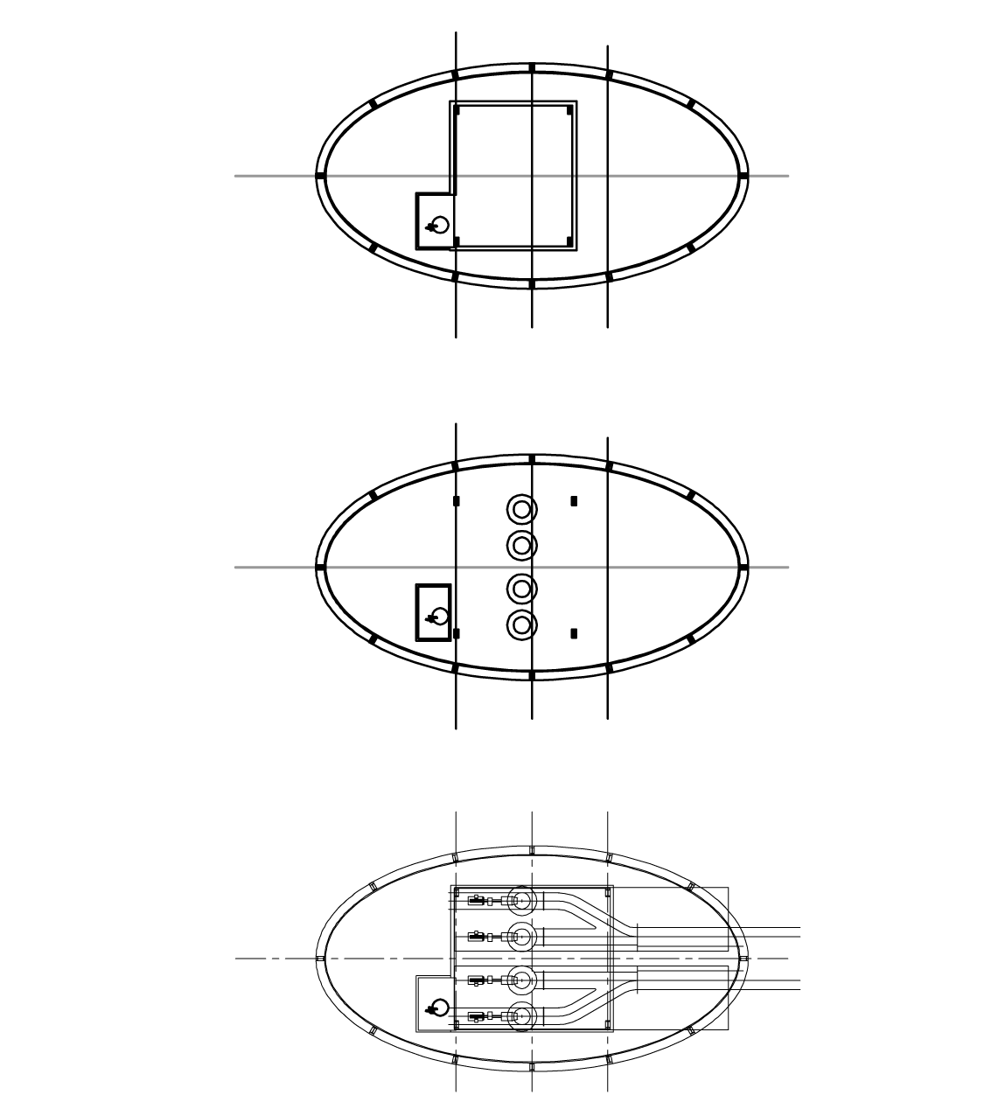
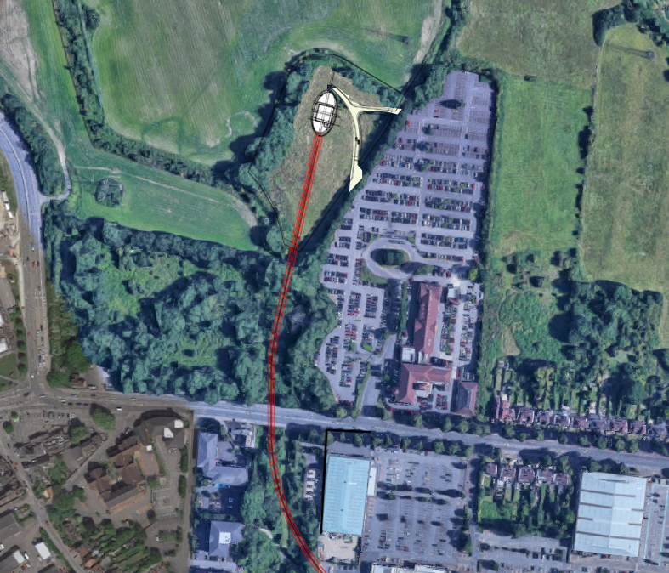
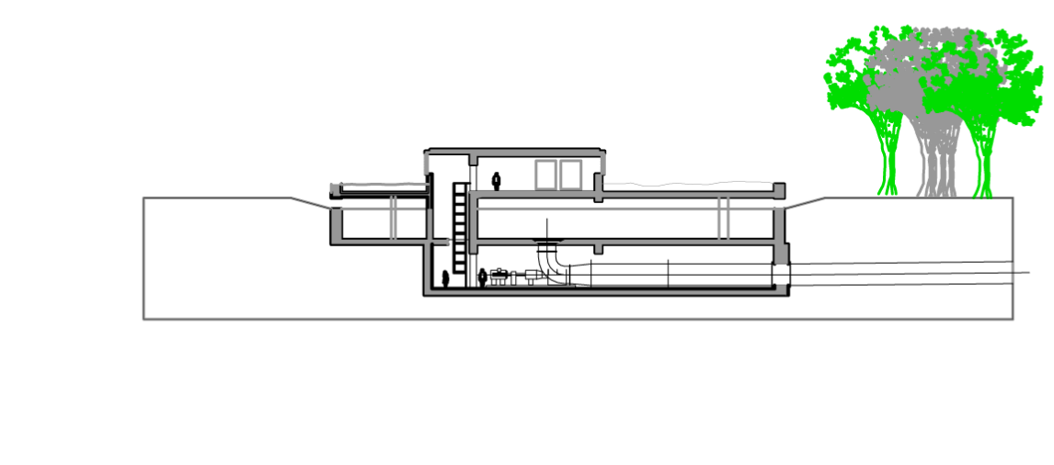
Top: Utilities – diesel electric standby generator; switch gear; fuel tanks.
Spillway diameter: 100m
Major axis: 40m
Minor axis: 20m
Pylon anchors with ‘H’ girders reinforce concrete surround and spillway.
ii) Penstock level: flood water intake into axial flow pumps.
iii) Axial flow pump room. Sub-ground level. Four pump output converged into two pipes.
Grassed area surrounding utilities housing
Triple level plan and profile drawings of pump house.
Vehicular access to pump house from car park.
Flood level
Outlet of 2 x 2m diameter GRP pipes, on shallow gradient to ca. 2.5m depth.
Profile of spillway into penstock and pumping system. Spillway protected with grilles to control debris ingress.

Slide 3
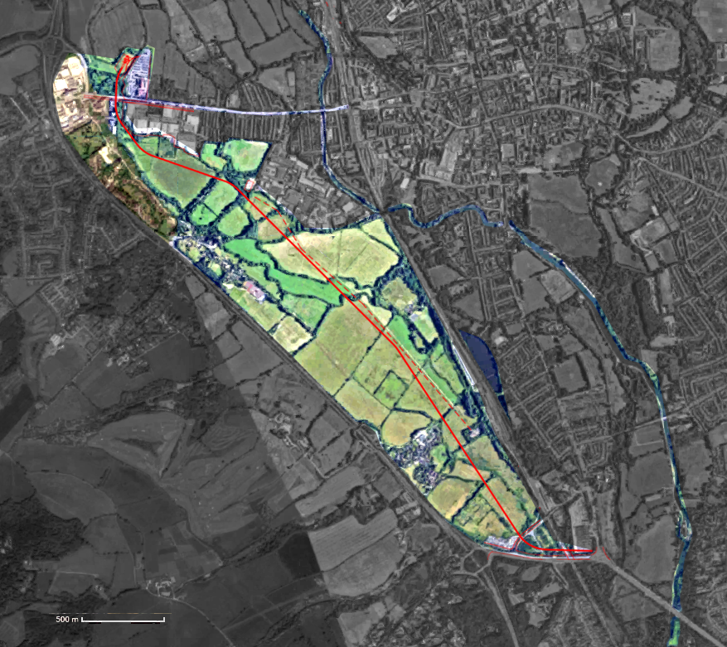
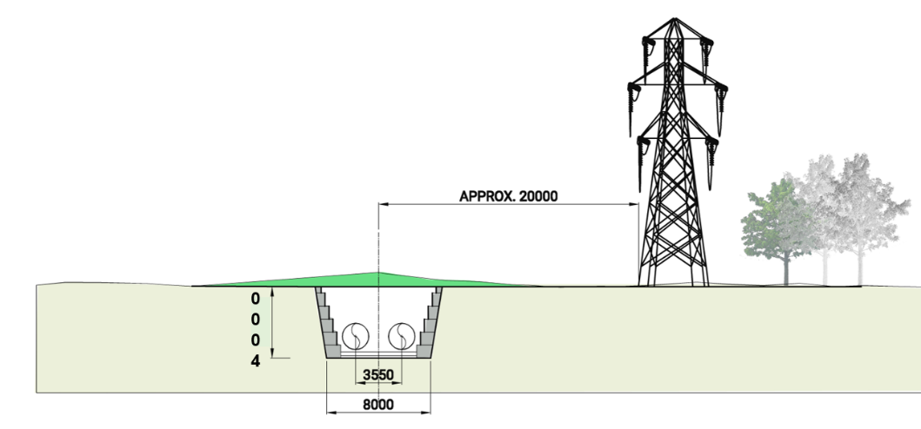
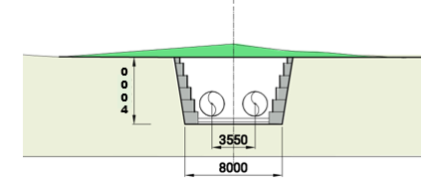
X-sections showing buried pipeline in trench to scale parallel to the Electric Road. (Measurements in mm)

Slide 4
Location of pump house, adjacent to Seacourt Park and Ride.
Pipeline route across the level meadows. Turning radii, minimum 200m for pipe route using GRP pipe construction.
Pipeline at OAR. The complex engineering in this area demands more detailed design. Safeguarding of pumped concept is key.

Slide 5
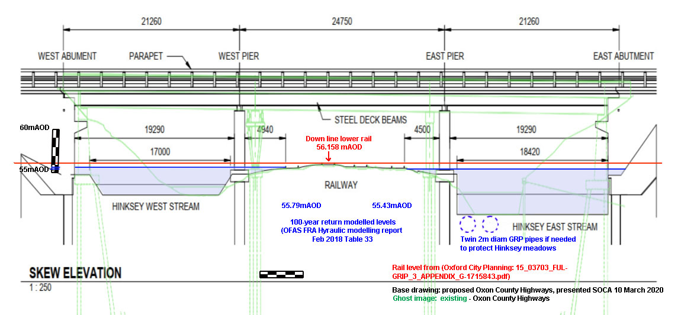

Slide 6
Advantages of Pumped Pipeline System
Uses well understood techniques and designs, common for water management and fluid transport in general
Consists of a small number of elements that can be replicated as required
Can be scaled to move water volumes equivalent to and greater than OFAS channel. 44 Cumets/sec as presently designed.
Is cost efficient in terms of equipment and civil engineering
Low volume of spoil removal off site reduces heavy vehicle movements on local and main roads. (Spoil from pump house excavation to be redeployed on pipeline route area.)
Reinstatement of existing landscape eliminates need for annual environmental maintenance costs.

Slide 7
Advantages of Pumped Pipeline System (cont’d)
Pumped scheme is additive, and contributes more than 40cumets/sec over and above gravity flow off the Meadow.
Pipes can be incorporated into the new Bypass overbridge East channel, and will not impede water passage in the railway area.
Water level monitoring along the Thames permits commencement of pumping at an early stage of flooding, thereby reducing peak flood levels.
Pumping station can be controlled remotely.

Slide 8
Hardware elements for construction of pumped system
Glass Reinforced Plastic Pipe (GRP) sections, 2m diameter, with flange couplings. Nominal length: 5km.
Four Axial flow pumps. 1.8m diameter. 7m/sec exit flow velocity.
2MW nominal power diesel-electric generator set, as mains electricity backup.
100m diameter elliptical spillway, feeding into penstock surrounding below ground level pump room. Nominal flood water depth over spillway 0.5m, at 1m/sec flow rate.
Pump system exit manifold combining four pump outlets into two pipelines.
Discharge race into Thames of 30m length, baffled to disperse water energy.

Slide 9
Specific Advantages of Pumped System over OFAS Channel
No spoil from trench or pump house excavations needs to be removed from site. (Pump house foundation spoil can be redistributed on site.)
Spoil will be backfilled into trench, and surplus made up into shallow surface bund of ca. 0.75m max. height over top of pipeline route.
Surplus soil volume estimated at 45,000 cumets. 0.75m bund of 30m width will use ca. 50,000 cumets of spoil.
Small cross-sectional area of pipes permits traverse of obstacles and conduits while not significantly obstructing additional gravity water flow.
Location of pump house is flexible. Most self-evident case is presented here, with maximum pipeline length.
In principle, pump house can be built towards southern end of meadows, thereby using gravity drainage across existing meadow morphology to control water level upstream. Capacity can be increased to ca. 60cumets/s.
Minimal spoil removal from site considerably reduces truck movements on access and main roads.

Slide 10
Pumped Scheme: Approximate Costings:
Hinksey and Osney Environment Group
Pumped Pipeline Alternative Proposal: Outline Costings
 | Item: |  |  |  | Cost: (£1,000) |  | Notes:
i) | GRP Pipe Sections: 5km, 2m diameter. Twin Pipes |  |  |  | £2,000 |  | Pipe Sections, delivered as telescoped sections of increasing diameter
ii) | Four x 1.8m dia. Axial Flow Pumps |  |  |  | £2,000 |  | Low pressure head, high volume. With Cycloconverter high-torque start system. 3+1 redundancy, to maintain full flow rate.
iii) | Steel 'Y' manifolds from pump outlets to main 2m pipes |  |  |  | £250 |  | Steel ‘Y’ manifolds, bringing output from four pumps into two, 2m dia. pipes. Equipped with valves to permit flexible operation with fewer than four pumps.
iv) | 2MW Standby Backup Diesel Generator and switchgear |  |  |  | £600 |  | Reconditioned, used unit. Switchgear for transfer from grid in case of outage. Located over pump room, above flood level.
v) | Pump House |  |  |  | £1,600 |  | ‘Swimming Pool’ concept, excavated to 10m depth.
vi) | Inlet spillway |  |  |  | £750 |  | Reinforced concrete, elliptical profile, with varying OD elevation, for graded floodwater ingress.
vii) | Penstock |  |  |  | £250 |  | Epoxy screed penstock, guiding flood water into pump inlets.

Slide 11
Costings: cont’d
viii) | Pipelaying onto concrete supports |  |  | £1,500 |  | Anchoring to control float forces by flexible steel bands
ix) | Trenching, and backfill. Shallow bund construction |  |  | £4,000 |  | Est. £25/cumet, for 150,000 cumets.
x) | Sheet piling for trench wall support. |  |  | £1,000 |  | If required. Dependent upon groundwater conditions.
xi) | Design |  |  | £1,000 |  | Engineering design. Environmental and archaeological studies.
xii) | Discharge Race |  |  | £200 |  | 30m reinforced concrete ramp, baffled
xiii) | Landscaping |  |  | £2,000 |  | Recover landscape to previous state. Plant trees and grasses. Reinstate footbridges etc.
xiv) | Electrical Connection to Mains |  |  | £250 |  | Connect to national grid
 |  |  | Total: | £17,400
 | Contingency for uncertainty in ground works, other on-site work, etc. |  |  | £5,000
 |  |  | Extended Total: | £22,400 |  | * Note: Does not include work in OAR/Railway/Bypass area.

